Slide 1
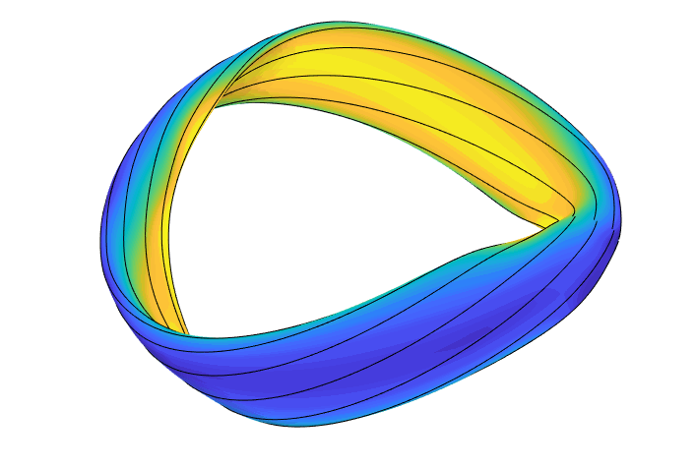
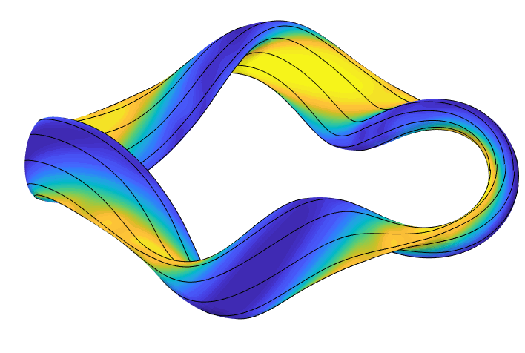
Direct construction of stellarator shapes with good confinement
Matt Landreman¹, Wrick Sengupta², Gabe Plunk³ , Per Helander³ 1. University of Maryland 2. NYU 3. IPP
J Plasma Phys 84, 905840616 (2018) J Plasma Phys 85, 905850103 (2019) PPCF 61, 075001 (2019) arXiv:1909.08919 arXiv:1908.10253 github.com/landreman/quasisymmetry

Slide 2
Advantages of stellarators: steady-state, no disruptions, no power recirculated for current drive, no Greenwald limit, don’t rely on plasma for confinement.

Slide 3
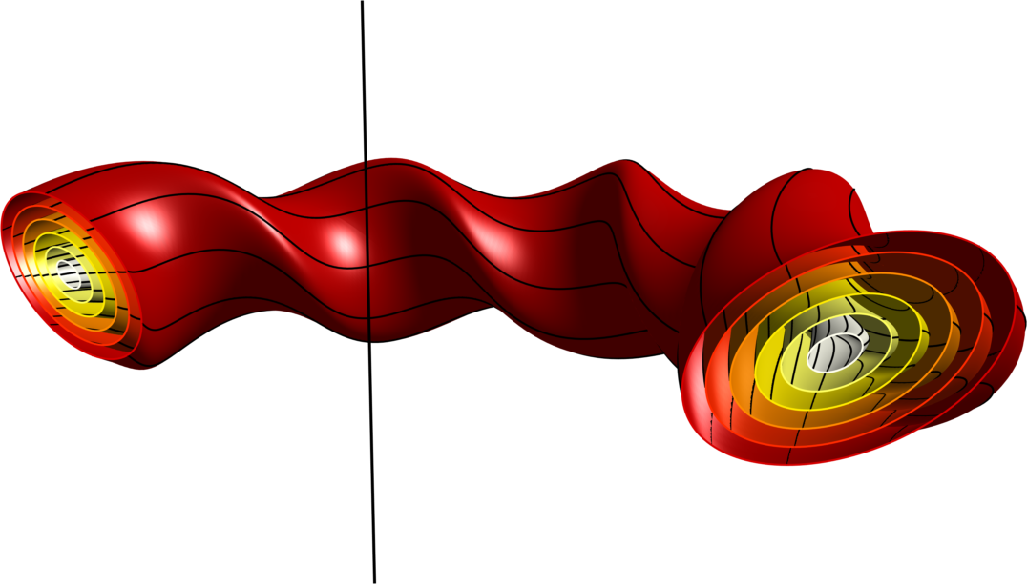
Advantages of stellarators: steady-state, no disruptions, no power recirculated for current drive, no Greenwald limit, don’t rely on plasma for confinement.
But, alpha losses & neoclassical transport would be too large unless you carefully choose the geometry.

Slide 4
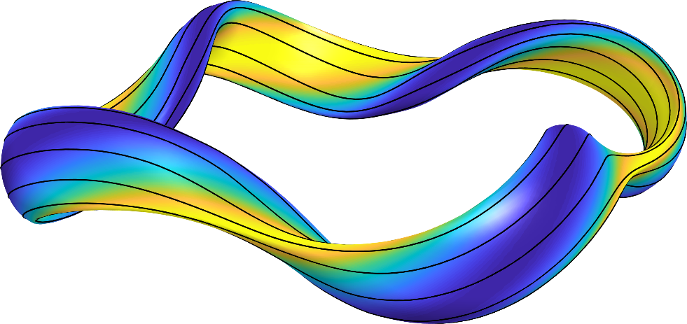
Advantages of stellarators: steady-state, no disruptions, no power recirculated for current drive, no Greenwald limit, don’t rely on plasma for confinement.
But, alpha losses & neoclassical transport would be too large unless you carefully choose the geometry.
A solution: quasisymmetry
Boozer angles
Guiding-center Lagrangian in Boozer coordinates depends on (𝜃,𝜁) only through B=|B|.

Slide 5
Advantages of stellarators: steady-state, no disruptions, no power recirculated for current drive, no Greenwald limit, don’t rely on plasma for confinement.
But, alpha losses & neoclassical transport would be too large unless you carefully choose the geometry.
A solution: quasisymmetry
Boozer angles
(Or, weaker conditions like omnigenity)

Slide 6
Advantages of stellarators: steady-state, no disruptions, no power recirculated for current drive, no Greenwald limit, don’t rely on plasma for confinement.
But, alpha losses & neoclassical transport would be too large unless you carefully choose the geometry.
A solution: quasisymmetry
Boozer angles
(Or, weaker conditions like omnigenity)
How do you find MHD equilibria with these properties?

Slide 7

The conventional approach to finding quasisymmetric fields works but has shortcomings
Want magnetic field strength B to have quasisymmetry:

Slide 8
The conventional approach to finding quasisymmetric fields works but has shortcomings
Want magnetic field strength B to have quasisymmetry:

Slide 9
The conventional approach to finding quasisymmetric fields works but has shortcomings
Want magnetic field strength B to have quasisymmetry:
Computationally expensive.
What is the size & character of the solution space?
Result depends on initial condition, so cannot be sure you’ve found all solutions.

Slide 10
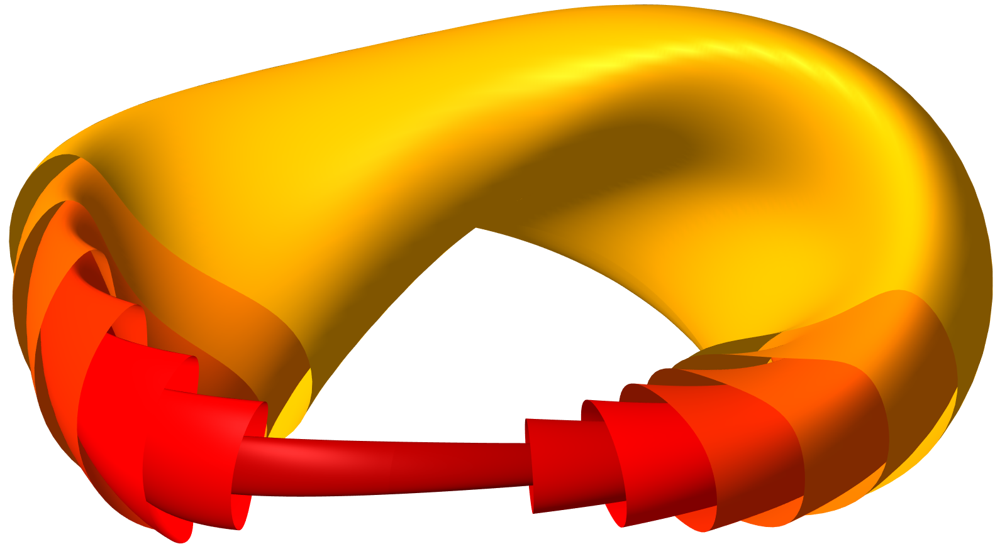
Expansion about the magnetic axis can be a powerful practical tool for generating quasisymmetric & omnigenous stellarators
Accurate at least in the core of any configuration.
Hasn’t been considered much since numerical optimization began in ~1980s.

Slide 11
Expansion about the magnetic axis can be a powerful practical tool for generating quasisymmetric & omnigenous stellarators
Accurate at least in the core of any configuration.
Hasn’t been considered much since numerical optimization began in ~1980s.
Complements the traditional optimization approach:
  Many orders of magnitude faster.
  You can parameterize all possible solutions.
  Can generate new initial conditions that can be refined by optimization.

Slide 12
Outline
Theory for O(r) quasisymmetry
Comparison to optimized configurations
The landscape of solutions
O(r) omnigenity
O(r²) quasisymmetry

Slide 13
Outline
Theory for O(r) quasisymmetry
Comparison to optimized configurations
The landscape of solutions
O(r) omnigenity
O(r²) quasisymmetry

Slide 14
Garren & Boozer (1991): Write position vector x using axis’s Frenet frame, expand in small r

Slide 15
Garren & Boozer (1991): Write position vector x using axis’s Frenet frame, expand in small r
Same for Y & Z.

Slide 16
Garren & Boozer (1991): Write position vector x using axis’s Frenet frame, expand in small r
Same for Y & Z.

Slide 17
Garren & Boozer (1991): Write position vector x using axis’s Frenet frame, expand in small r
Same for Y & Z.

Slide 18
Garren & Boozer (1991): Write position vector x using axis’s Frenet frame, expand in small r
Same for Y & Z.

Slide 19
Garren & Boozer’s equations yield a practical algorithm
Inputs:
Shape of the magnetic axis, with 𝜅 ≠ 0. (Determines QA vs QH.)
3 real numbers:
  I₂: Current density on the axis. (Usually 0).
  𝜎(0): Rotation of the elliptical flux surfaces at toroidal angle=0.
  , which controls elongation and field strength:
(Pressure doesn’t matter to this order.)

Slide 20
Garren & Boozer’s equations yield a practical algorithm
Inputs:
Shape of the magnetic axis, with 𝜅 ≠ 0. (Determines QA vs QH.)
3 real numbers:
  I₂: Current density on the axis. (Usually 0).
  𝜎(0): Rotation of the elliptical flux surfaces at toroidal angle=0.
  , which controls elongation and field strength:
(Pressure doesn’t matter to this order.)
Theorem: Given this data, a unique O(r) quasisymmetric solution exists.
⟹ The size of the space of configurations that are quasisymmetric to O(r) is precisely understood.
ML, Sengupta, & Plunk, J Plasma Phys 85, 905850103 (2019)

Slide 21
Garren & Boozer’s equations yield a practical algorithm
Inputs:
Shape of the magnetic axis, with 𝜅 ≠ 0. (Determines QA vs QH.)
3 real numbers:
  I₂: Current density on the axis. (Usually 0).
  𝜎(0): Rotation of the elliptical flux surfaces at toroidal angle=0.
  , which controls elongation and field strength:
(Pressure doesn’t matter to this order.)
Theorem: Given this data, a unique O(r) quasisymmetric solution exists.
Outputs:
Shape of the surfaces around the axis. (Elongation & rotation of ellipses.)
Rotational transform on axis.

Slide 22
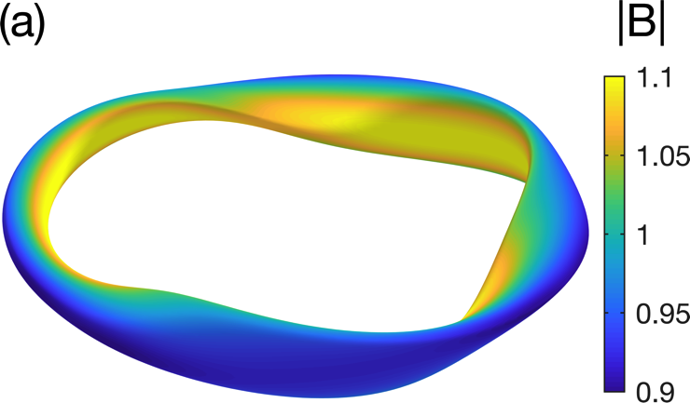
Example construction: quasi-axisymmetry
Inputs:
Plug in r = 0.1 m.
Results:
B [T]
Z [m]
R [m]

Slide 23
The construction can be verified by running an MHD equilibrium code (VMEC) which does not make the expansion.
Inputs:
Results: (R/a = 10)
B [T]
Z [m]
R [m]

Slide 24
Outline
Theory for O(r) quasisymmetry
Comparison to optimized configurations
The landscape of solutions
O(r) omnigenity
O(r²) quasisymmetry

Slide 25
The construction can be fit to quasisymmetric stellarators designed by optimization
Adopt the same axis shape.
Fit to minimize difference in the shapes of a near-axis surface.

Slide 26
The direct construction gives an accurate match to the on-axis rotational transform in quasisymmetric stellarators designed by optimization
Adopt the same axis shape.
Fit to minimize difference in the shapes of a near-axis surface.
NCSX

Slide 27
The direct construction gives an accurate match to the near-axis surface shapes of quasisymmetric stellarators designed by optimization
Dotted: VMEC equilibrium
Solid: Garren-Boozer construction
HSX
Henneberg et al
r/a=0.1
r/a=0.2

Slide 28
Outline
Theory for O(r) quasisymmetry
Comparison to optimized configurations
The landscape of solutions
O(r) omnigenity
O(r²) quasisymmetry

Slide 29
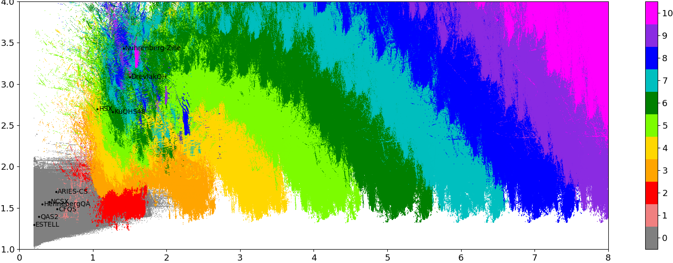
The fast construction enables brute-force surveys of ”all” quasisymmetric fields
2.4x10⁸
configurations
Maximum axis curvature
Color = N = # of times B contours rotate around magnetic axis
Rotational transform

Slide 30
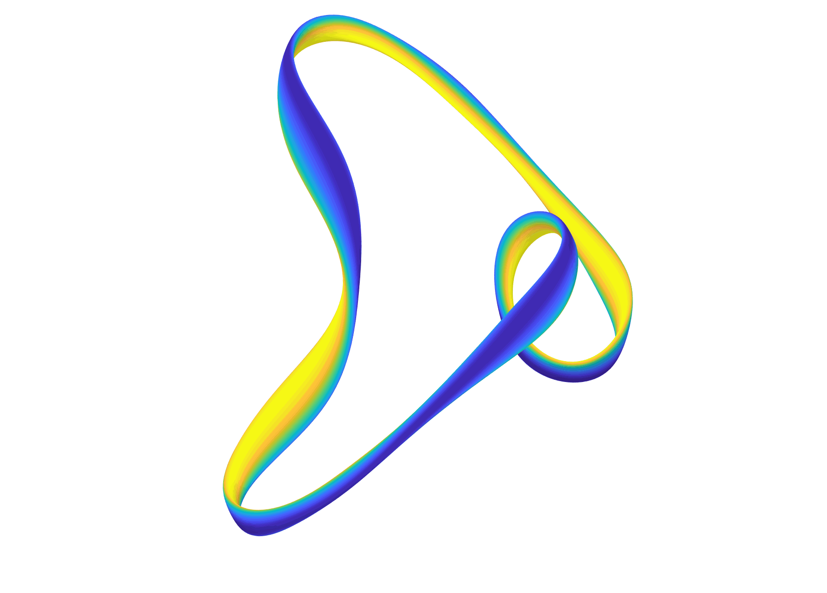
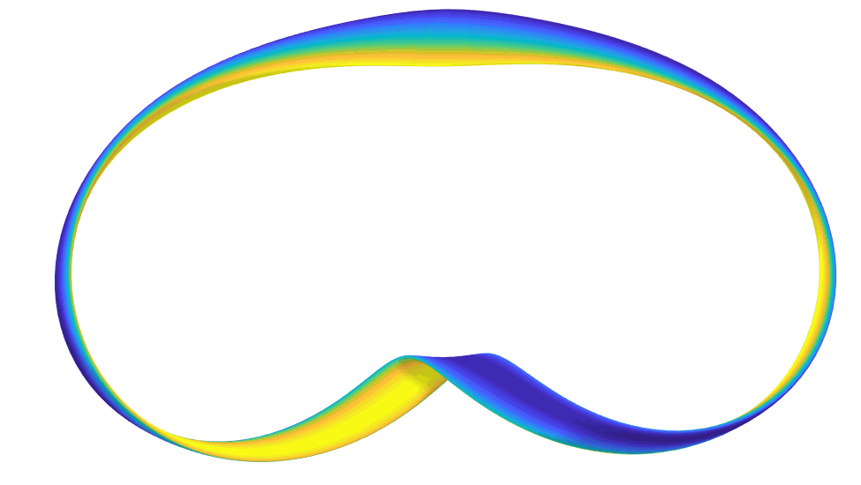
Brute-force searching is already yielding some new configurations
Quasi-helical symmetry with
1 field period
2 field periods

Slide 31
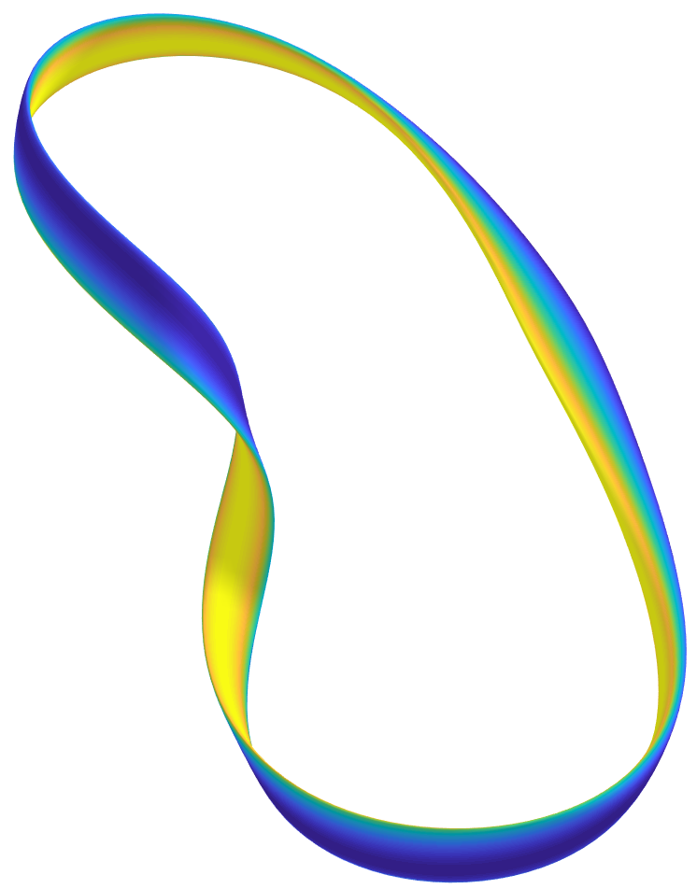
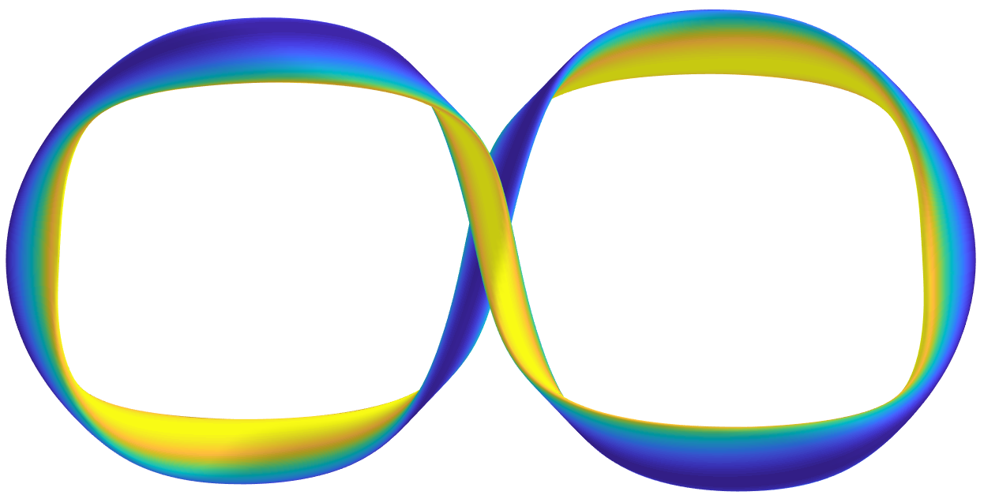
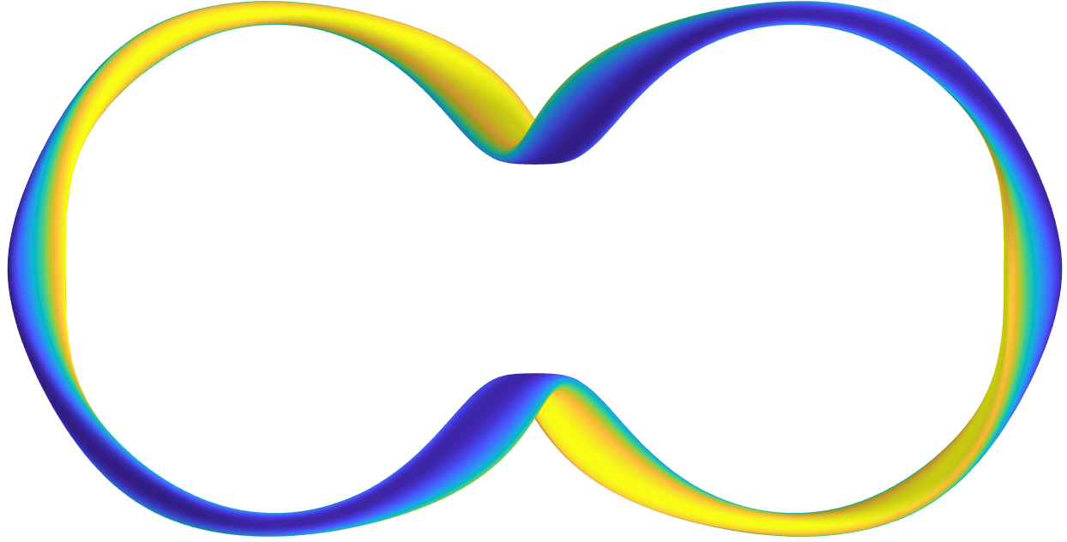
Brute-force searching is already yielding some new configurations
Quasi-helical symmetry with
1 field period
2 field periods

Slide 32
Outline
Theory for O(r) quasisymmetry
Comparison to optimized configurations
The landscape of solutions
O(r) omnigenity
O(r²) quasisymmetry

Slide 33
The near-axis analysis can be generalized to construct omnigenous configurations
G G Plunk, ML, and P Helander, arXiv:1909.08919, Accepted in J Plasma Phys
Omnigenity:
bounce

Slide 34
The near-axis analysis can be generalized to construct omnigenous configurations
G G Plunk, ML, and P Helander, arXiv:1909.08919, Accepted in J Plasma Phys
Omnigenity:
bounce
Implications for B(r,𝜃,𝜁):
[Cary & Shasharina (1997)]
All B contours close toroidally, helically, or poloidally.
Distance along B between bounce points is the same for every field line on a flux surface.
B [T]
B [T]
✘
✓

Slide 35
The near-axis analysis can be generalized to construct omnigenous configurations
G G Plunk, ML, and P Helander, arXiv:1909.08919, Accepted in J Plasma Phys
Omnigenity:
bounce
Implications for B(r,𝜃,𝜁):
[Cary & Shasharina (1997)]
All B contours close toroidally, helically, or poloidally.
Distance along B between bounce points is the same for every field line on a flux surface.
Garren & Boozer (1991):
for any equilibrium, not just quasisymmetry.

Slide 36
The near-axis analysis can be generalized to construct omnigenous configurations
G G Plunk, ML, and P Helander, arXiv:1909.08919, Accepted in J Plasma Phys
Omnigenity:
bounce
Implications for B(r,𝜃,𝜁):
[Cary & Shasharina (1997)]
All B contours close toroidally, helically, or poloidally.
Distance along B between bounce points is the same for every field line on a flux surface.
Garren & Boozer (1991):
for any equilibrium, not just quasisymmetry.
(Cary & Shasharina 1997) + (Garren & Boozer 1991) = (Plunk et al 2019)

Slide 37
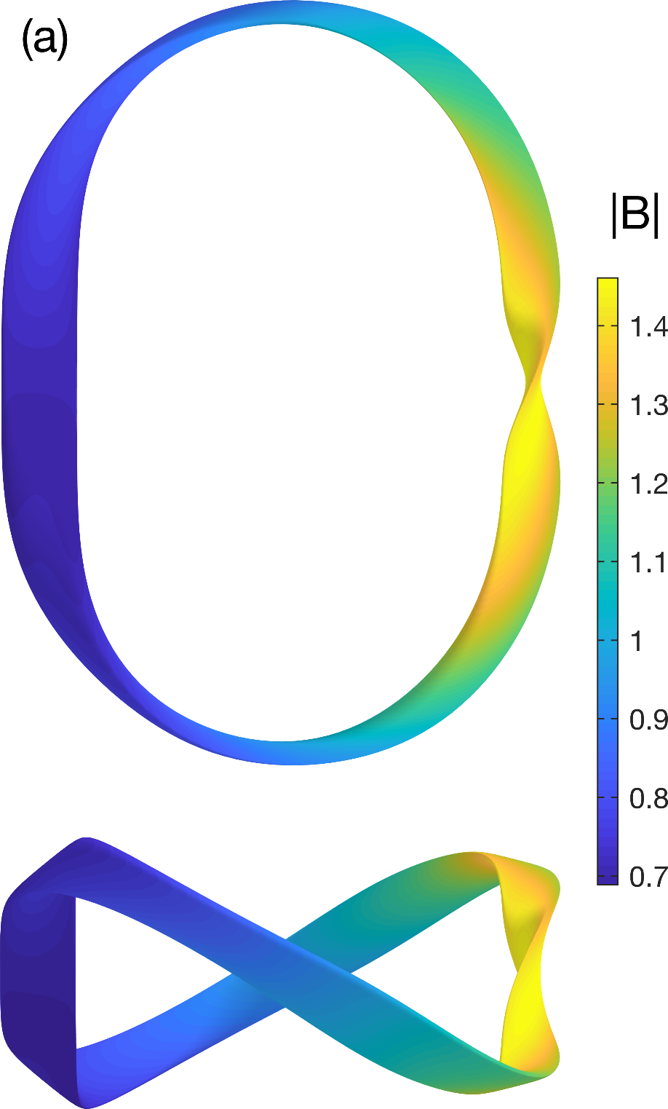
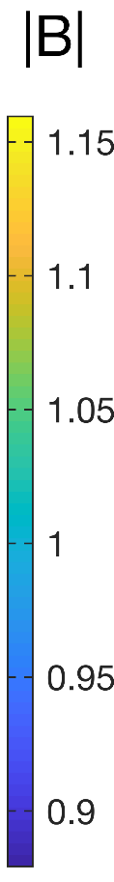
The near-axis analysis can be generalized to construct omnigenous configurations

Slide 38
The near-axis analysis can be generalized to construct omnigenous configurations

Slide 39
Outline
Theory for O(r) quasisymmetry
Comparison to optimized configurations
The landscape of solutions
O(r) omnigenity
O(r²) quasisymmetry

Slide 40
The O(r²) construction allows triangularity, Shafranov shift, and more accurate quasisymmetry.
Same for Y & Z.

Slide 41
The O(r²) construction allows triangularity, Shafranov shift, and more accurate quasisymmetry.
Same for Y & Z.
3 new input parameters: p₂, B_{2c}, B_{2s}.

Slide 42
The O(r²) construction allows triangularity, Shafranov shift, and more accurate quasisymmetry.
Same for Y & Z.
3 new input parameters: p₂, B_{2c}, B_{2s}.
Net loss of 1 degree of freedom. My approach: B₂₀(𝜁) is an output. Need to adjust inputs so B₂₀(𝜁) ≈ constant.

Slide 43
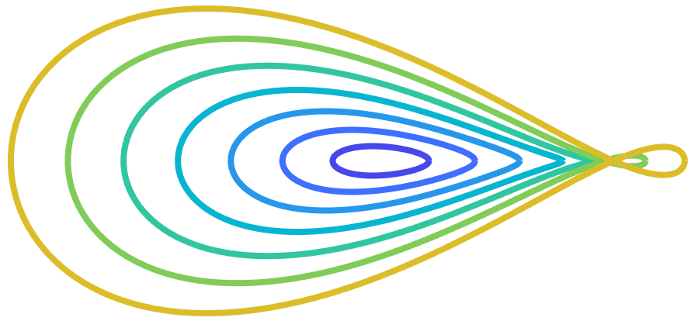
The O(r²) construction allows triangularity, Shafranov shift, and more accurate quasisymmetry.
Same for Y & Z.
3 new input parameters: p₂, B_{2c}, B_{2s}.
Net loss of 1 degree of freedom. My approach: B₂₀(𝜁) is an output. Need to adjust inputs so B₂₀(𝜁) ≈ constant.
Minimize X₂ & Y₂, to maximize the r at which surfaces begin to self-intersect.

Slide 44
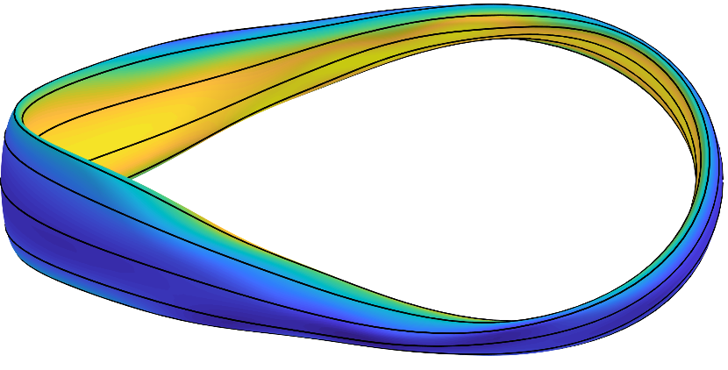
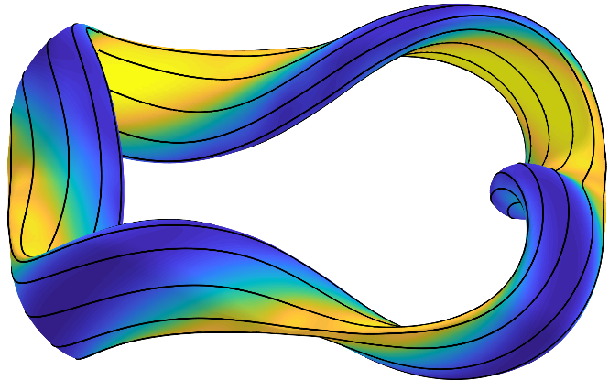
Examples of the O(r²) construction
QA
QH
𝜄 = 0.42
𝜄 = 1.14

Slide 45
Quasisymmetry expected for the O(r²) construction is confirmed by VMEC.
QA
QH

Slide 46


We can now numerically demonstrate Garren & Boozer’s scaling: B_{nonsymm} ~ 1/A³
QA
QH

Slide 47
We can now numerically demonstrate Garren & Boozer’s scaling: B_{nonsymm} ~ 1/A³
!
QA
QH

Slide 48
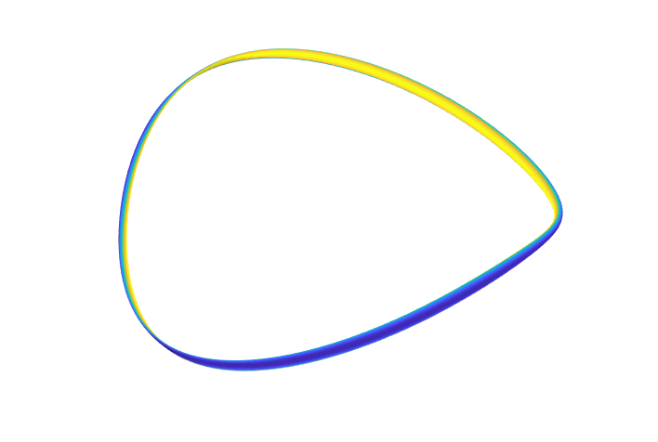
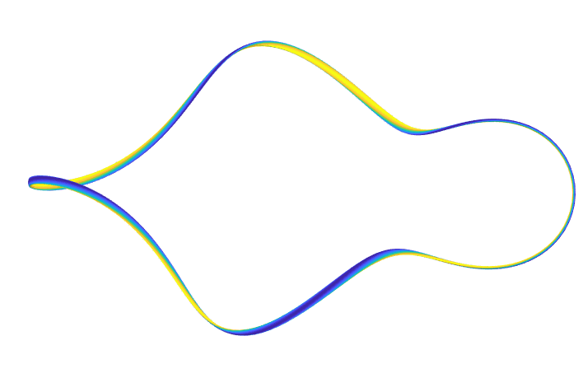
Quasisymmetry can be achieved to any desired precision, e.g. B_{nonsymm} ≤ B_{Earth}

Slide 49
Future work
Higher order: Calculate B₃ so symmetry-breaking can be minimized.
Examine MHD & gyrokinetic stability using the expansion.
Can anything be proved about the number or character of O(r²) solutions?
Is there an analogous construction to give quasisymmetry at an off-axis surface?
Check coil feasibility for newly discovered configurations.

Slide 50
Conclusions
The near-axis expansion enables transport-optimized stellarator configurations to be generated orders of magnitude faster than before.
We precisely understand the size of the space of magnetic fields that are quasisymmetric near the axis (to O(r)).
There is hope of definitively identifying all regions of parameter space with practical quasisymmetric fields (near the axis).
J Plasma Phys 84, 905840616 (2018) J Plasma Phys 85, 905850103 (2019) PPCF 61, 075001 (2019) arXiv:1909.08919 arXiv:1908.10253 github.com/landreman/quasisymmetry

Slide 51

Conclusions
The near-axis expansion enables transport-optimized stellarator configurations to be generated orders of magnitude faster than before.
We precisely understand the size of the space of magnetic fields that are quasisymmetric near the axis (to O(r)).
There is hope of definitively identifying all regions of parameter space with practical quasisymmetric fields (near the axis).
We might discover qualitatively new magnetic configurations for fusion?
J Plasma Phys 84, 905840616 (2018) J Plasma Phys 85, 905850103 (2019) PPCF 61, 075001 (2019) arXiv:1909.08919 arXiv:1908.10253 github.com/landreman/quasisymmetry

Slide 52
Extra slides

Slide 53
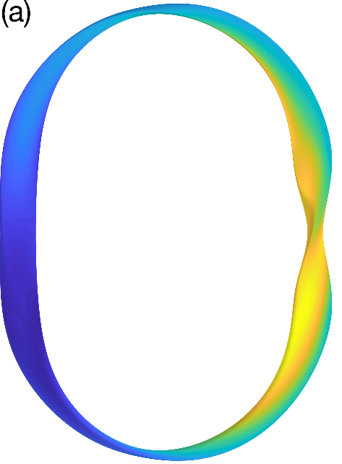
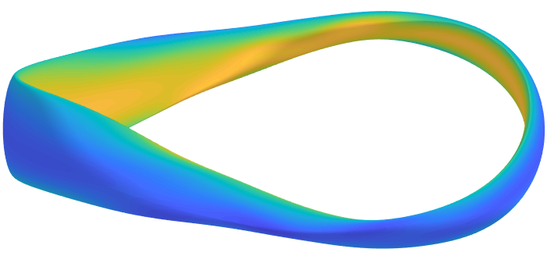
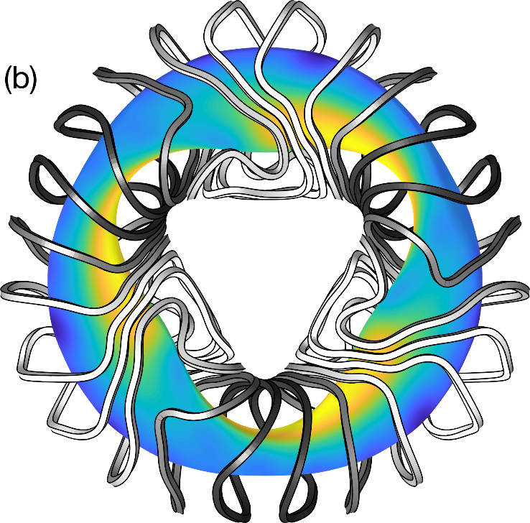
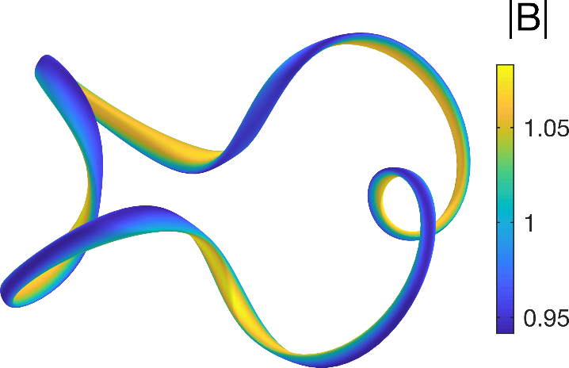
Expansion about the magnetic axis can be a powerful practical tool for generating quasisymmetric & omnigenous stellarators
Complements the traditional optimization approach:
Many orders of magnitude faster.
You can parameterize all possible solutions.
Can generate initial conditions that can be refined by optimization.

Slide 54

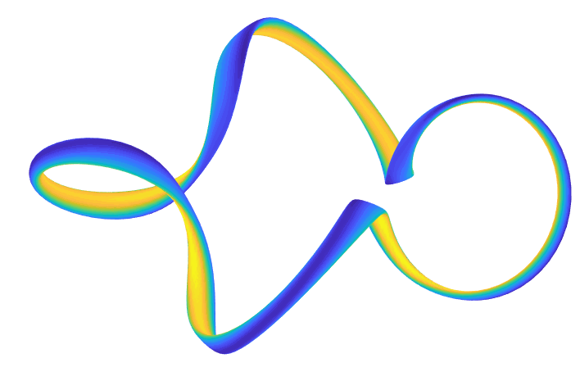
We now have a recipe for generating quasisymmetric VMEC input files:
Set r to a small finite value a.
Inputs:
Results:

Slide 55
We now have a recipe for generating quasisymmetric VMEC input files:
Set r to a small finite value a.
Inputs:
Results:

Slide 56
The construction can be verified by comparing to VMEC + BOOZ_XFORM.
Inputs:
Results:

Slide 57
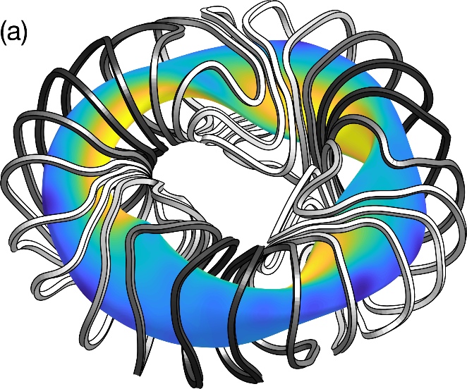

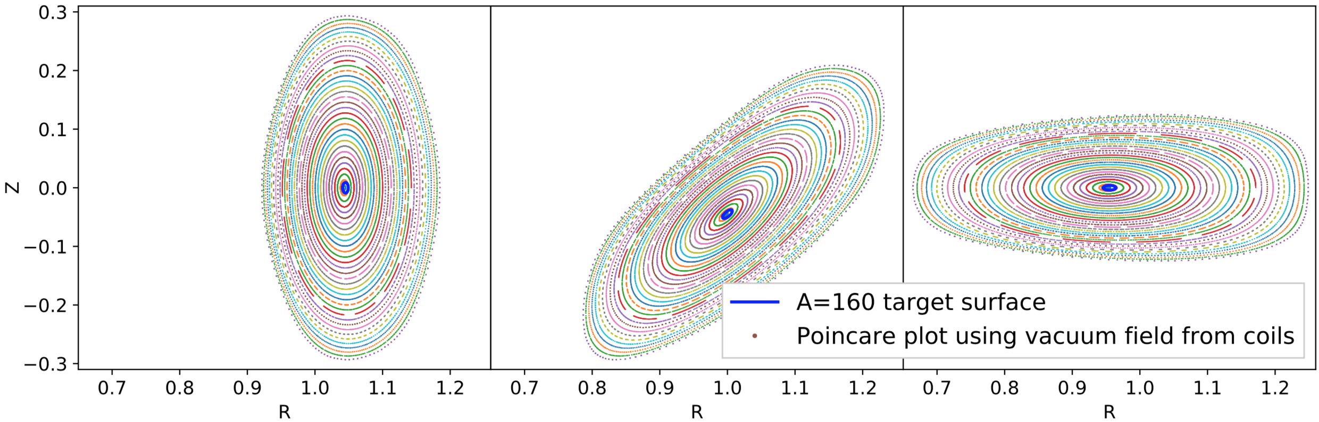
Alternative method to generate a finite-thickness boundary: find coils to make a skinny surface, then see what you get outside.

Slide 58
Alternative method to generate a finite-thickness boundary: find coils to make a skinny surface, then see what you get outside.

Slide 59
Quasi-axisymmetry vs quasi-helical symmetry is determined purely by the axis shape
So B contours rotate about axis with the same topology as n.

Slide 60
Quasi-axisymmetry vs quasi-helical symmetry is determined purely by the axis shape
So B contours rotate about axis with the same topology as n.
n
n does not rotate about the axis as you follow the axis around.
n rotates about the axis 4 times as you follow the axis around.

Slide 61

The fast construction enables brute-force surveys of ”all” quasisymmetric fields
2.4x10⁸
configurations
Maximum axis curvature
Color = # of times B contours rotate around magnetic axis
Rotational transform

Slide 62
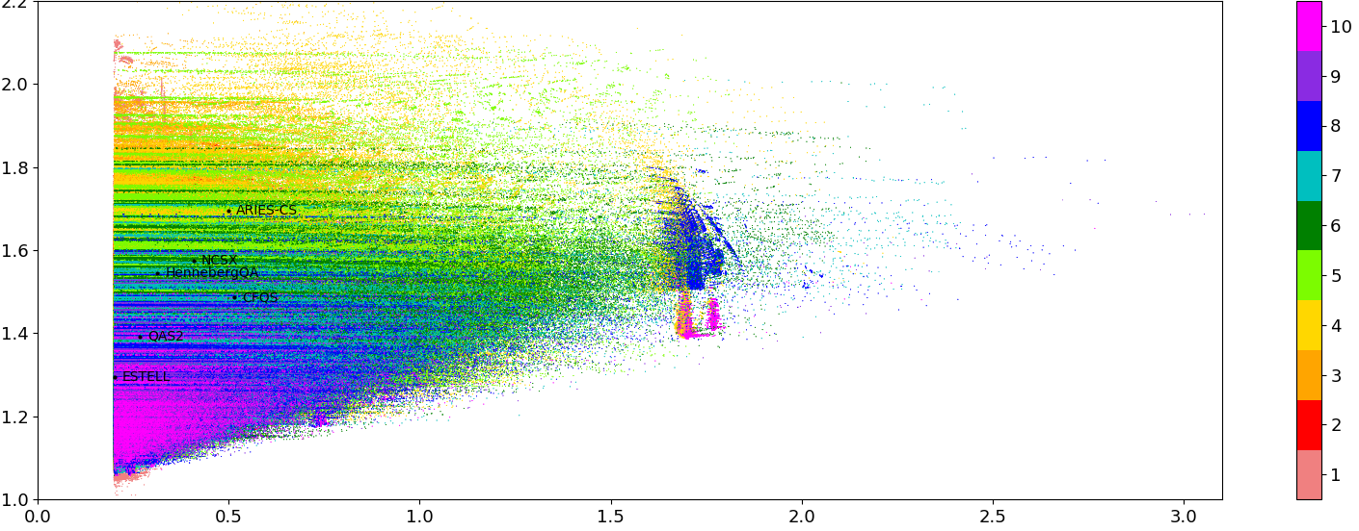
The fast construction enables brute-force surveys of ”all” quasisymmetric fields
4x10⁶
configurations
Quasi-axisymmetric solutions only
Maximum axis curvature
Color = n_{fp} (discrete rotational symmetry)
Rotational transform

Slide 63
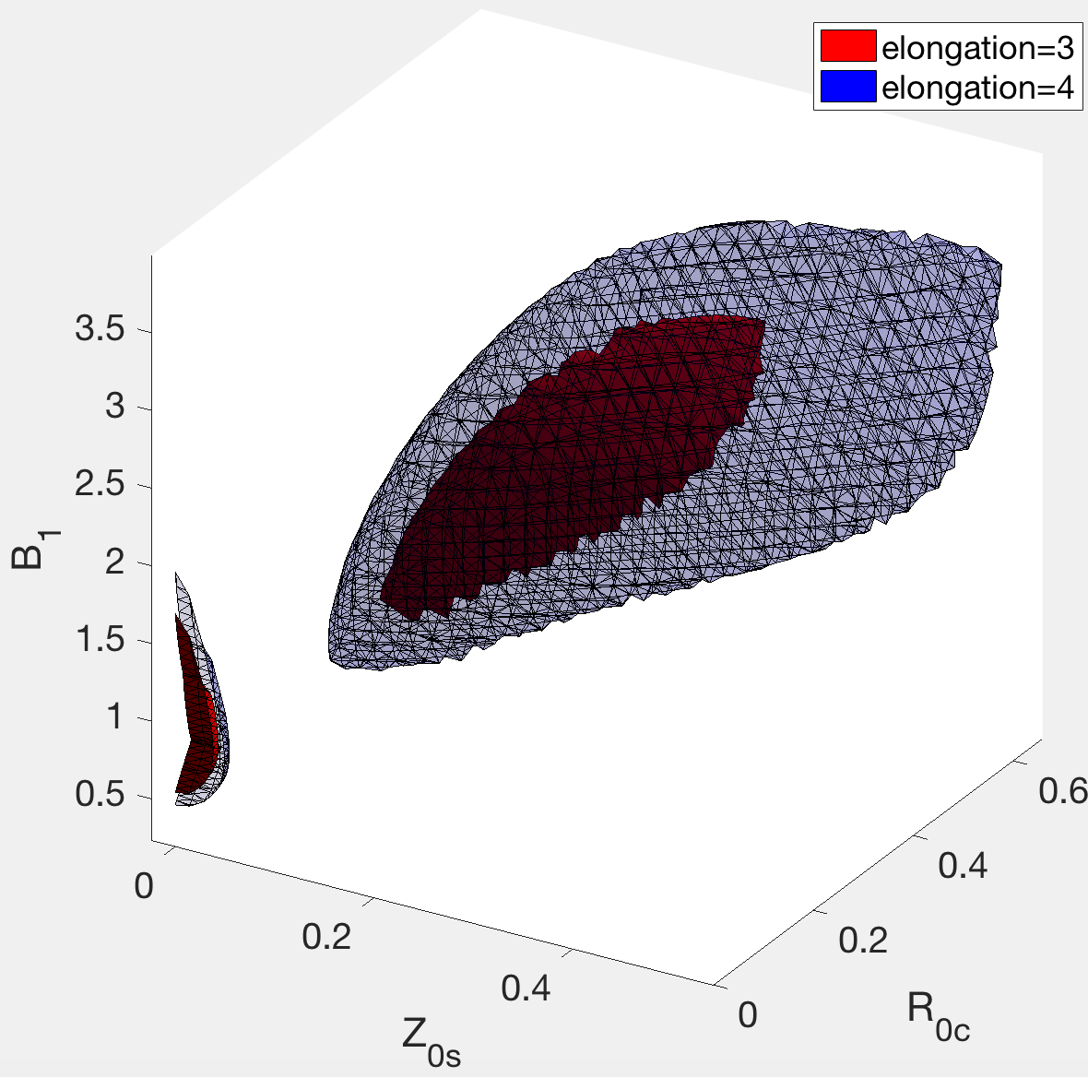
The construction enables fast scans over parameter space.
Quasi-helical symmetry
274,560 solutions generated in <30s on a laptop.
Quasi-axisymmetry

Slide 64
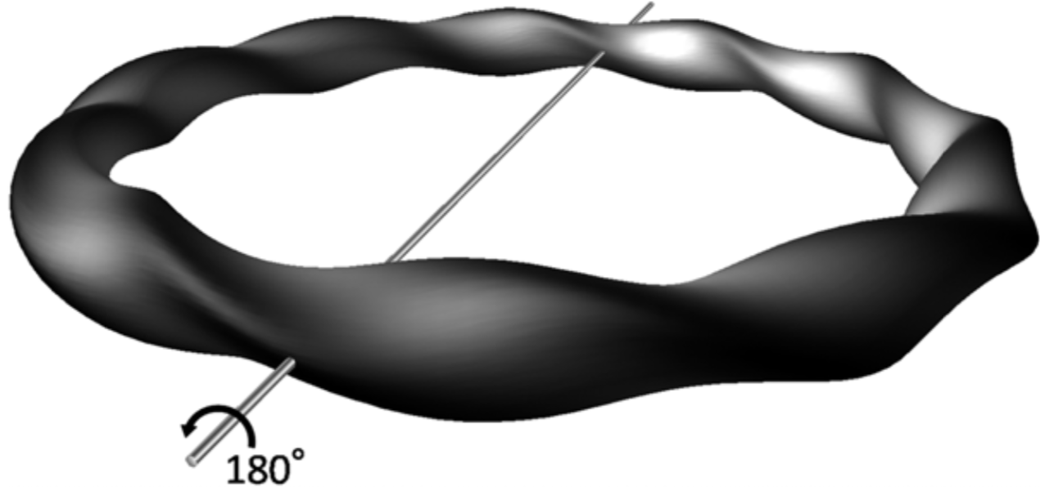
All stellarators built to date have ‘stellarator symmetry’, which is unrelated to quasisymmetry
Sugama et al (2011)

Slide 65
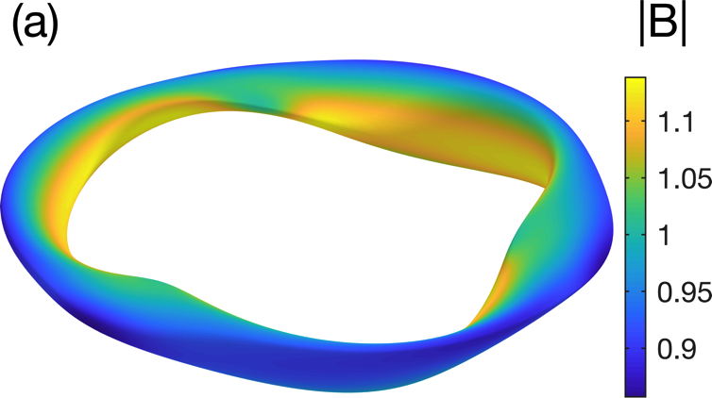
You can make a quasi-axisymmetric stellarator without stellarator symmetry
Inputs:
Results: (R/a = 10)

Slide 66
You can make a quasi-axisymmetric stellarator without stellarator symmetry
Inputs:
Results: (R/a = 10)

Slide 67
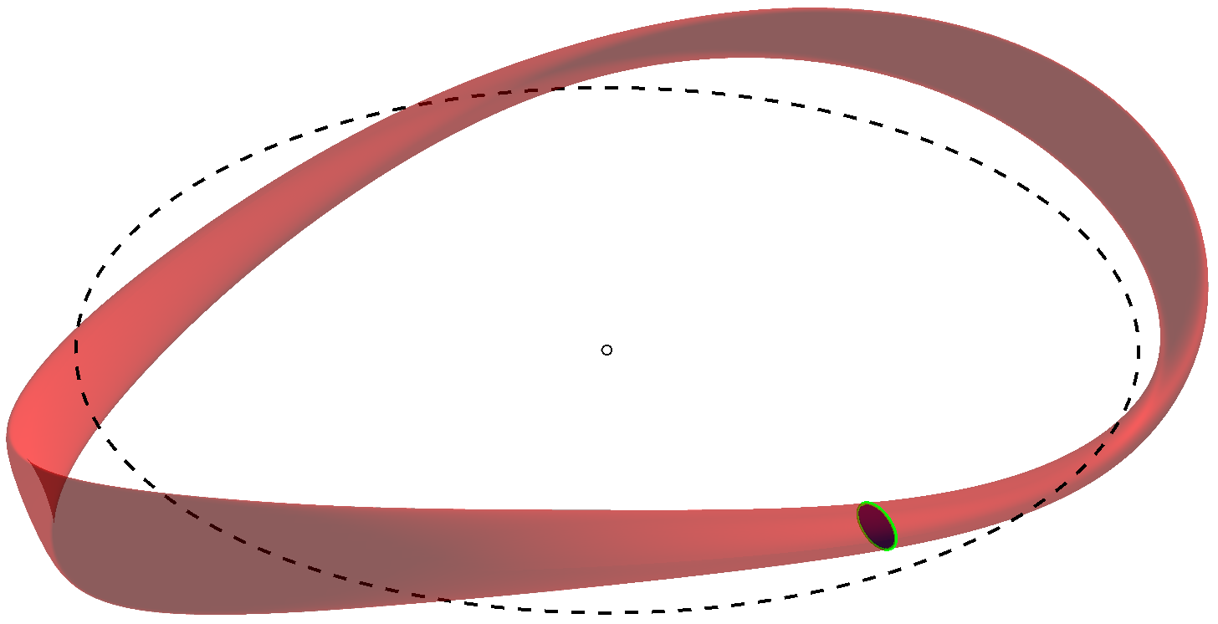
We will expand in the skinniness of the inner flux surfaces
Flux surface

Slide 68
Theory: Expand position vector using Frenet frame, equate 2 representations of B.

Slide 69
Theory: Write position vector using Frenet frame

Slide 70
Theory: Write position vector using Frenet frame, expand in small r = (flux)^{1/2}

Slide 71
Theory: Write position vector using Frenet frame, expand in small r = (flux)^{1/2}

Slide 72
Theory: Expand position vector using Frenet frame, equate 2 representations of B.

Slide 73
Theory: Expand position vector using Frenet frame, equate 2 representations of B.

Slide 74
Theory: Expand position vector using Frenet frame, equate 2 representations of B.

Slide 75
Theory: Expand position vector using Frenet frame, equate 2 representations of B.

Slide 76
The rotational transform computed by VMEC converges to the value computed by the Garren-Boozer approach.

Slide 77
The ODE is solved with spectral accuracy using pseudospectral discretization + Newton iteration

Slide 78
Of 10 configurations examined, the fit is less good for 2
Dotted: VMEC equilibrium
Solid: Garren-Boozer construction
ARIES-CS
CFQS

Slide 79
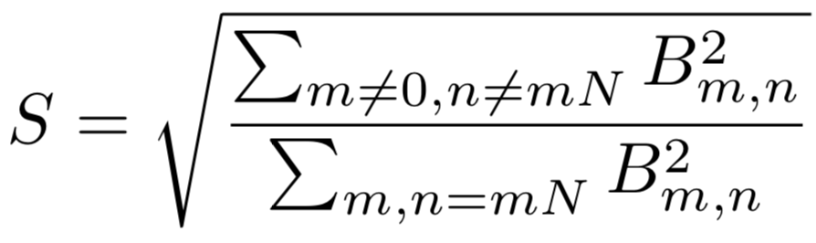
The configurations with relatively poor fits can be explained by their larger symmetry-breaking

Slide 80
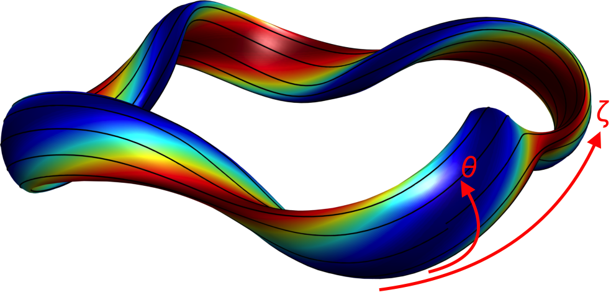
The conventional approach to finding quasisymmetric fields works but has shortcomings
Want magnetic field strength B to have quasisymmetry:

Slide 81
The conventional approach to finding quasisymmetric fields works but has shortcomings
Want magnetic field strength B to have quasisymmetry:

Slide 82
The conventional approach to finding quasisymmetric fields works but has shortcomings
Want magnetic field strength B to have quasisymmetry:
Computationally expensive.
What is the size & character of the solution space?
Result depends on initial condition, so cannot be sure you’ve found all solutions.

Slide 83
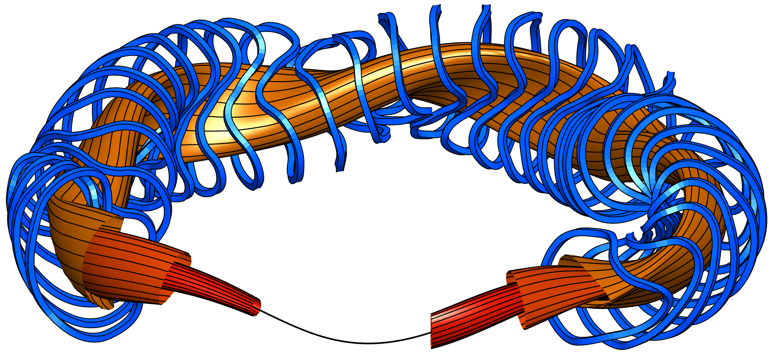
Alternative: expand equations near the magnetic axis
Flux surfaces
Magnetic axis
Magnetic field lines
Mercier (1964), Lortz & Nührenberg (1976), Garren & Boozer (1991)

Slide 84
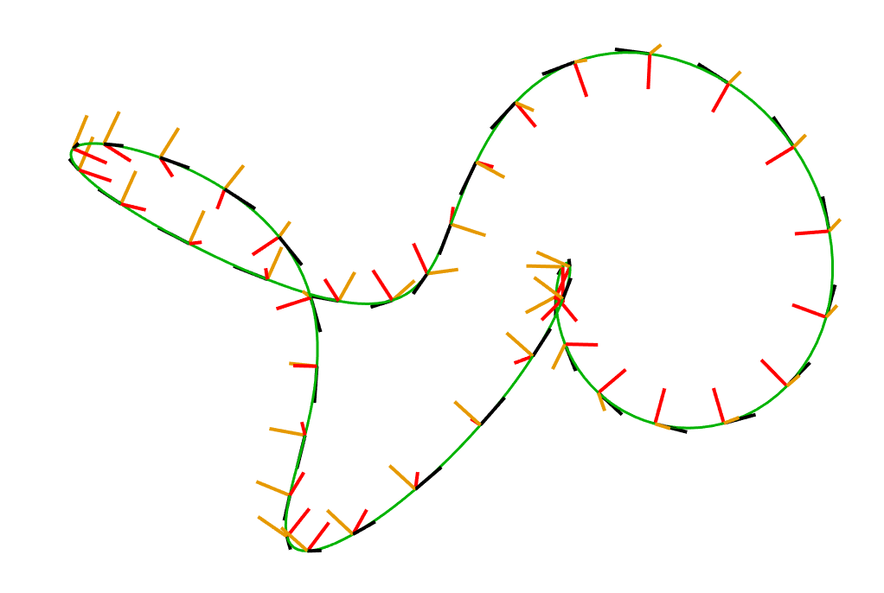
A key ingredient of the theory is the Frenet frame of the magnetic axis
Mercier (1964), Solovev & Shafranov (1970), Lortz & Nührenberg (1976), Garren & Boozer (1991)

Slide 85
A key ingredient of the theory is the Frenet frame of the magnetic axis
Mercier (1964), Solovev & Shafranov (1970), Lortz & Nührenberg (1976), Garren & Boozer (1991)

Slide 86
Garren & Boozer (1991): Write position vector x using axis’s Frenet frame, expand in small r

Slide 87
The size of the space of fields that are quasisymmetric to O(r) can be precisely understood.

Slide 88
The size of the space of fields that are quasisymmetric to O(r) can be precisely understood.
Theorem: A solution exists and it is unique.
ML, Sengupta, and Plunk (2019). Probably an earlier reference?

Slide 89
The size of the space of fields that are quasisymmetric to O(r) can be precisely understood.
Theorem: A solution exists and it is unique.

Slide 90
The symmetry-breaking Fourier amplitudes scale as predicted.

Slide 91
Quasi-helically symmetric configurations
Dotted: VMEC equilibrium
Solid: Garren-Boozer construction
HSX
L-P Ku (2011)
r/a=0.1
r/a=0.2

Slide 92
Quasi-axisymmetric configurations
Dotted: VMEC equilibrium
Solid: Garren-Boozer construction
NCSX
ESTELL

Slide 93
Omnigenity is a weaker confinement condition than quasisymmetry.
Definition of omnigenity: The radial drift has a time average of 0 for all particles.
J Cary & S Shasharina, Physics of Plasmas 4, 3323 (1997).
J Cary & S Shasharina, Physical Review Letters 78, 674 (1997).
P Helander & J Nührenberg, Plasma Physics and Controlled Fusion 51, 055004 (2009).
M Landreman & P J Catto, Physics of Plasmas 19, 056103 (2012).

Slide 94
Omnigenity is a weaker confinement condition than quasisymmetry.
Definition of omnigenity: The radial drift has a time average of 0 for all particles.
Generalized
quasi-axisymmetry
Generalized quasi-poloidal
symmetry
Generalized quasi-helical
symmetry
|B|
𝜃
𝜁
𝜁
𝜁

Slide 95

The near-axis analysis can be generalized to construct omnigenous configurations
G G Plunk, ML, and P Helander,
In preparation
Quasi-poloidal symmetry is not possible near the axis, but omnigenity is.

Slide 96
Outline
Construction for O(r) quasisymmetry
  Theory, & the number of solutions
  Numerical results
  Comparison to “real experiments”
  The landscape of solutions
Extensions
  Omnigenity
  O(r²) quasisymmetry

Slide 97
Extending the construction to higher order is tricky
We can only “half-specify” the axis shape:
  A curve like the axis is given by 2 functions, e.g. {curvature, torsion} or {R(𝝓), Z(𝝓)}.
  At O(r), (# unknowns)-(# equations)=2 so we can specify (almost) any axis. But at O(r²), (# unknowns)-(# equations)=1 so we cannot.

Slide 98
Extending the construction to higher order is tricky
We can only “half-specify” the axis shape:
  A curve like the axis is given by 2 functions, e.g. {curvature, torsion} or {R(𝝓), Z(𝝓)}.
  At O(r), (# unknowns)-(# equations)=2 so we can specify (almost) any axis. But at O(r²), (# unknowns)-(# equations)=1 so we cannot.
No existence & uniqueness theorem for solutions (yet).
Magnetic shear (variation of rotational transform) does not appear until O(r³).

Slide 99
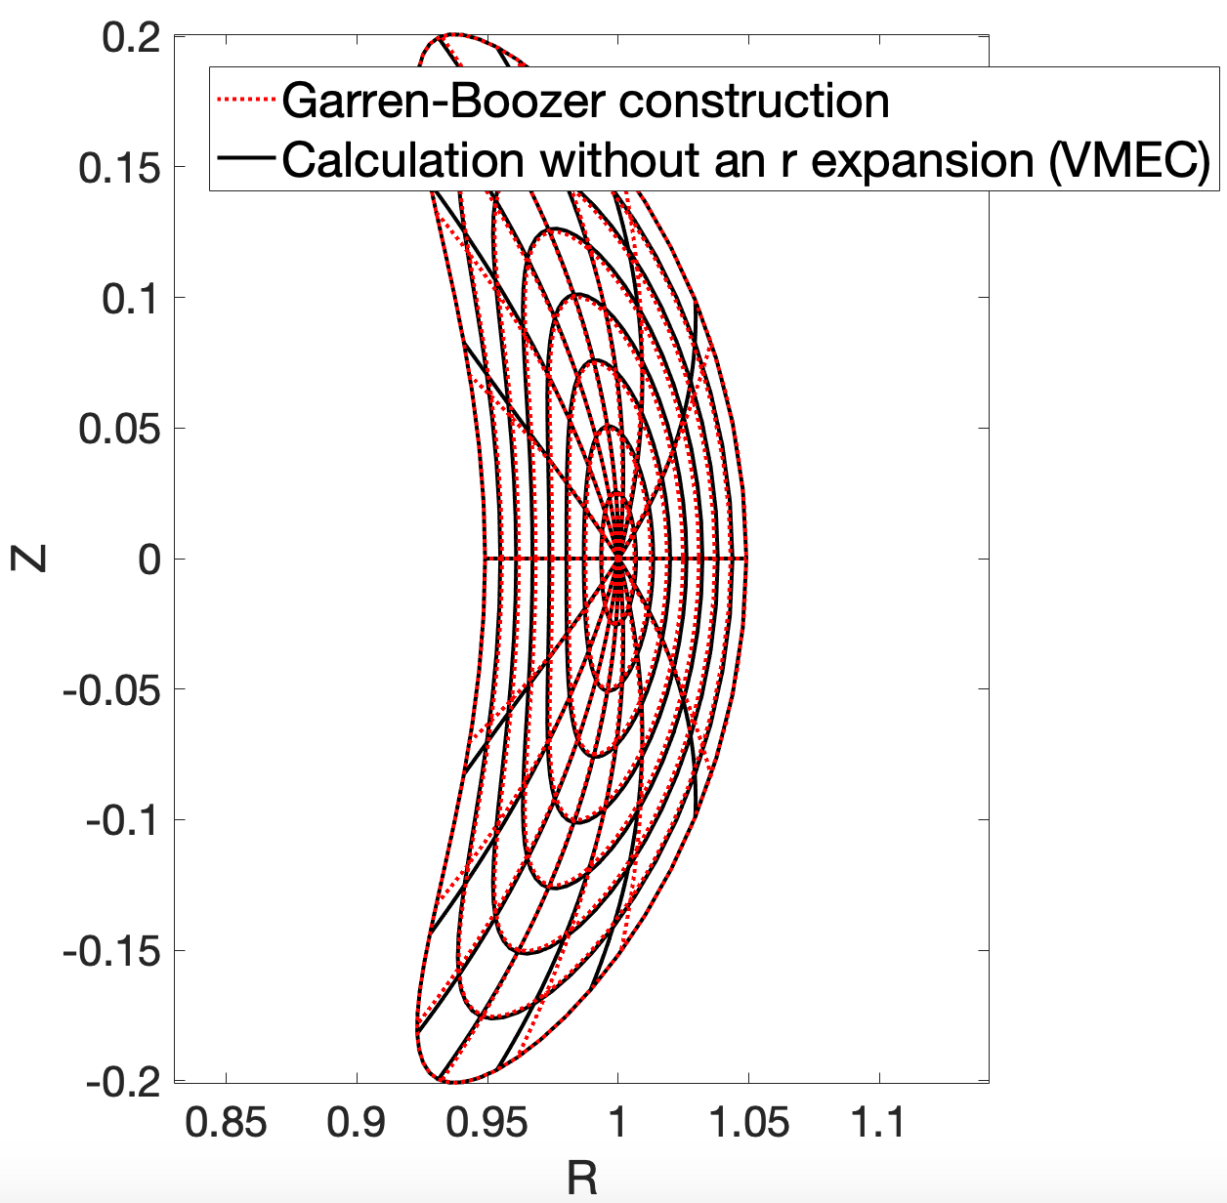
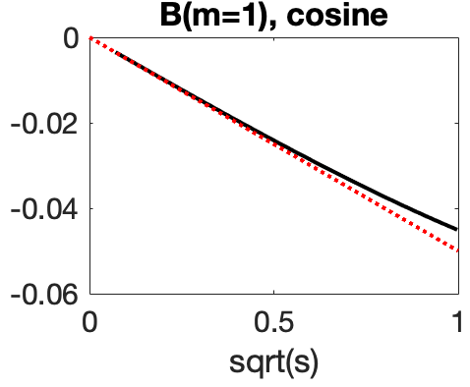
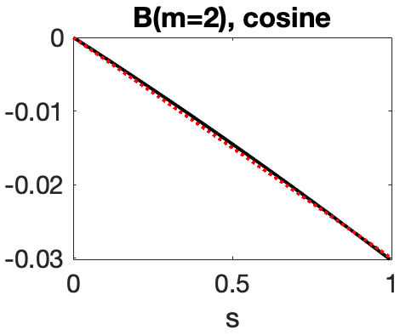
We are working to extend the construction to O(r²), enabling greater shaping
Axisymmetric
example:
Achieved
Requested
Achieved
Const 𝜃_{Boozer} curves
Requested

Slide 100
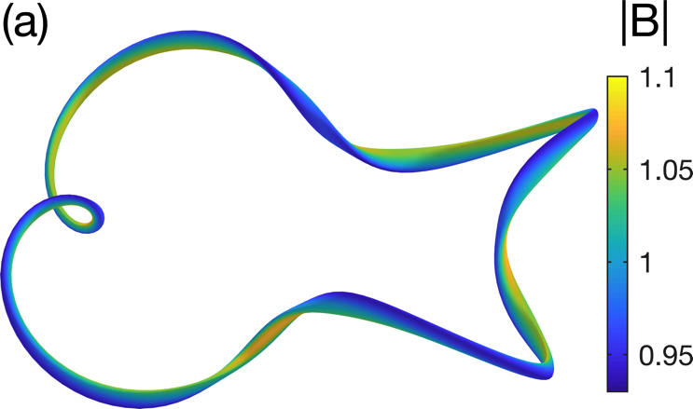
We now have a recipe for generating quasisymmetric VMEC input files:
Set r to a small finite value a.
Inputs:
Results:

Slide 101
The construction can be verified by comparing to VMEC + BOOZ_XFORM.
Inputs:
Results: (R/a = 40)

Slide 102
The fast construction enables brute-force surveys of ”all” quasisymmetric fields
2.4x10⁸
configurations
Maximum axis curvature
Color = # of times B contours rotate around magnetic axis
Rotational transform

Slide 103
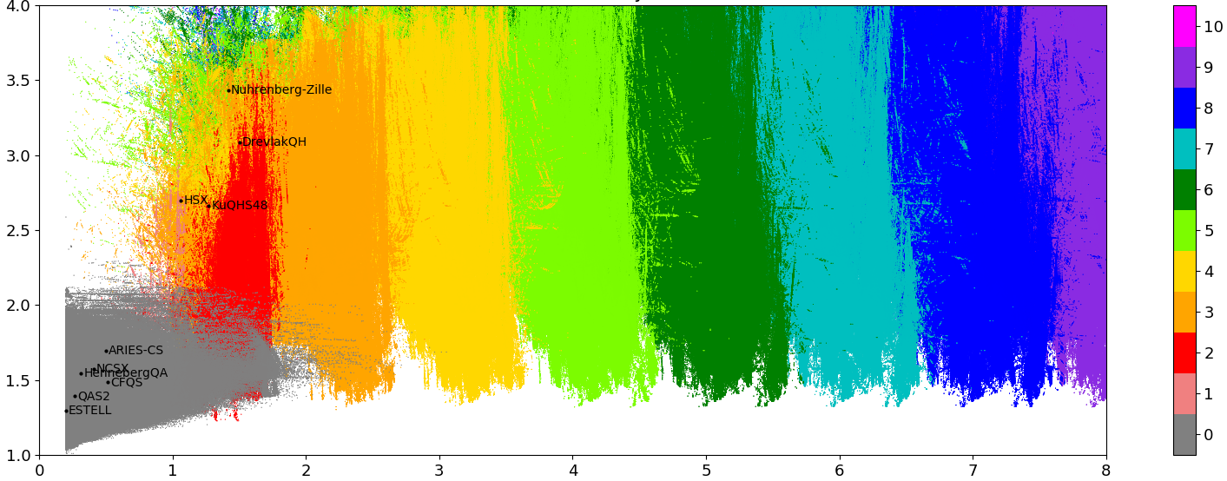
The fast construction enables brute-force surveys of ”all” quasisymmetric fields
2.4x10⁸
configurations
Maximum axis curvature
Color = # of times B contours rotate around magnetic axis
Rotational transform

Slide 104
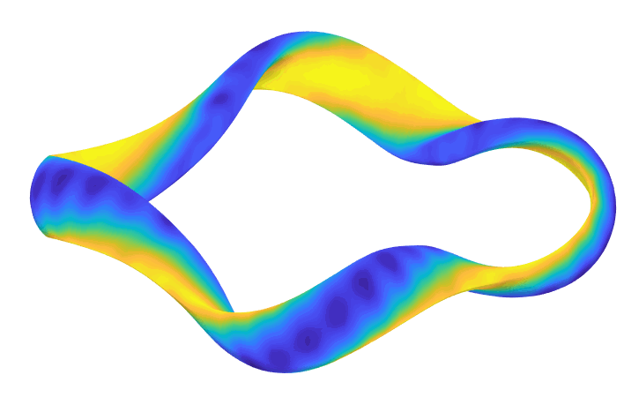
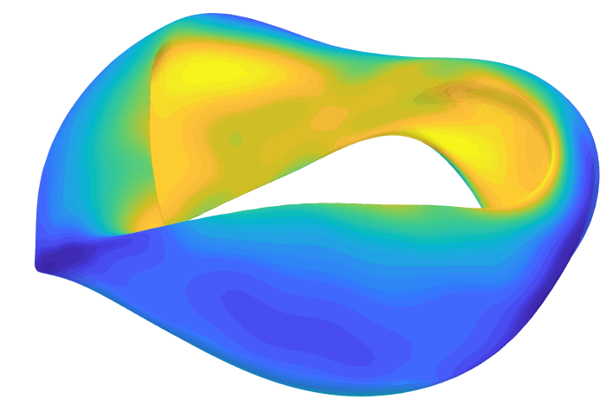
Quasisymmetric experiments to date actually have significant departures from symmetry.

Slide 105
Example of the O(r²) construction
Inputs:

Slide 106
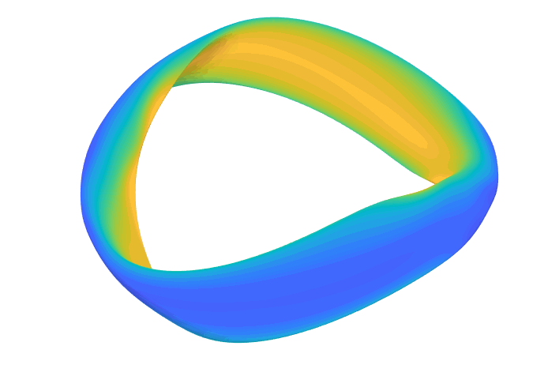
Example of the O(r²) construction
Inputs:
Results:

Slide 107
The O(r²) construction allows triangularity and more accurate quasisymmetry.
Same for Y & Z.
3 new input parameters: p₂, B_{2c}, B_{2s}.
Net loss of 1 degree of freedom. My approach: B₂₀(𝜁) is an output. Need to adjust inputs so B₂₀(𝜁) ≈ constant.
Shafranov shift appears at this order. Matches textbook tokamak result (e.g. Wesson, Hazeltine & Meiss):

Slide 109
Garren & Boozer (1991): Write position vector x using axis’s Frenet frame, expand in small r
Results for quasisymmetry through O(r):

Slide 110
The size of the space of fields that are quasisymmetric to O(r) can be precisely understood.
Inputs:
Shape of the magnetic axis. (Determines QA vs QH.)
3 real numbers:
  I₂: Current density on the axis. (Usually 0).
  𝜎(0): Rotation of the elliptical flux surfaces at toroidal angle=0.
  , which controls elongation and field strength:
(Pressure doesn’t matter to this order.)
Theorem: Given this data, a quasisymmetric solution exists, & it is unique.

Slide 111
Conclusions
The equations for quasisymmetric magnetic fields can be solved directly and rapidly if you expand about the magnetic axis.
The resulting construction can be useful for generating new initial conditions for optimization.
We precisely understand the size of the space of magnetic fields that are quasisymmetric near the axis (to O(r)).
There is hope of definitively identifying all regions of parameter space with practical quasisymmetric fields (near the axis).
We can discover qualitatively new magnetic configurations for fusion.
J Plasma Phys 84, 905840616 (2018) J Plasma Phys 85, 905850103 (2019) PPCF 61, 075001 (2019) arXiv:1909.08919 arXiv:1908.10253 github.com/landreman/quasisymmetry

Slide 112
Parameter space (independent variables)
Coil shapes: arbitrary 3D curves
Coil currents
Input parameters of the Garren-Boozer near-axis quasisymmetry equations:
  Shape of magnetic axis (independent from the axis actually produced by coils!)

Slide 113
Objective function
Differentiate Biot-Savart law

Slide 114
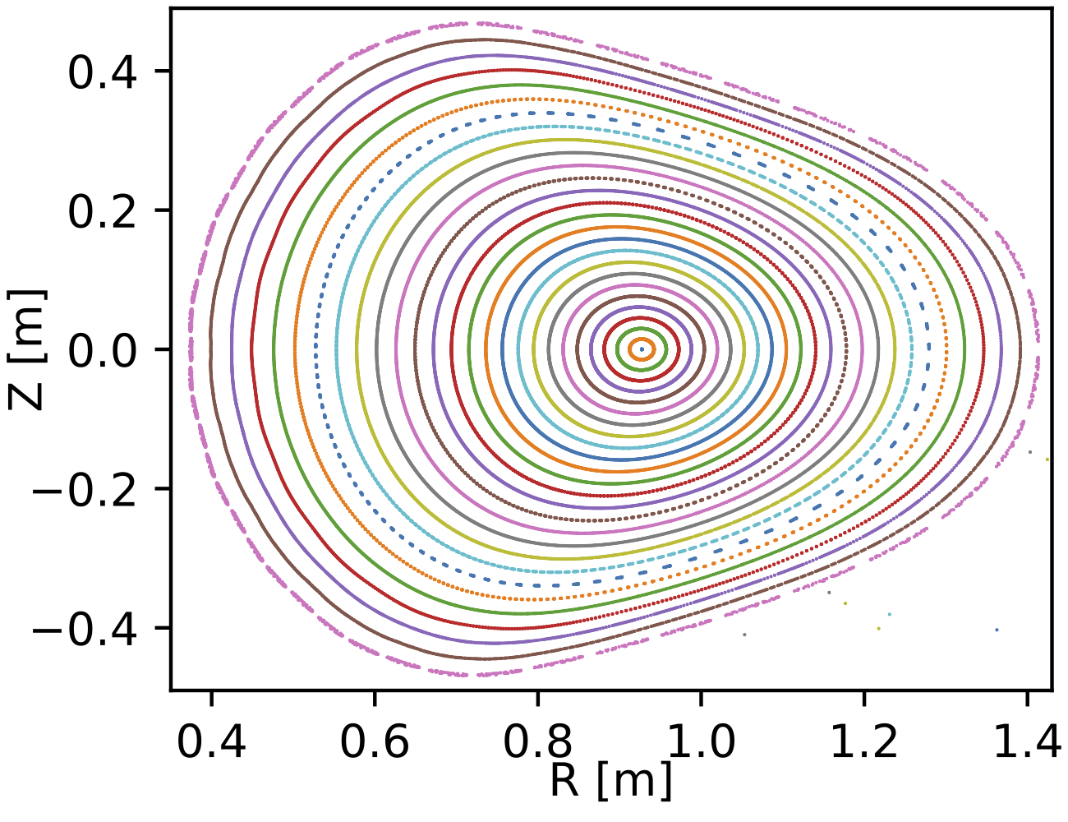
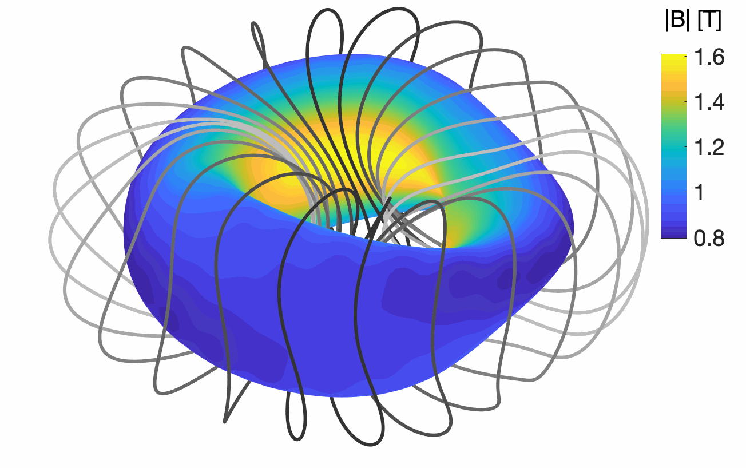
Combined coil + quasisymmetry optimization using analytic derivatives successfully achieves flux surfaces & QA
Good vacuum surfaces out to A=1.96
Good quasisymmetry in core
Combined optimization takes < 1 hour * 1 cpu in Matlab prototype code. Could surely be accelerated.

